Slide 1



Visualising Research Data: From Raw Numbers to Scientific Impact
Dr Luke Power
Research, Innovation And Impact
South East Technological University

Slide 2
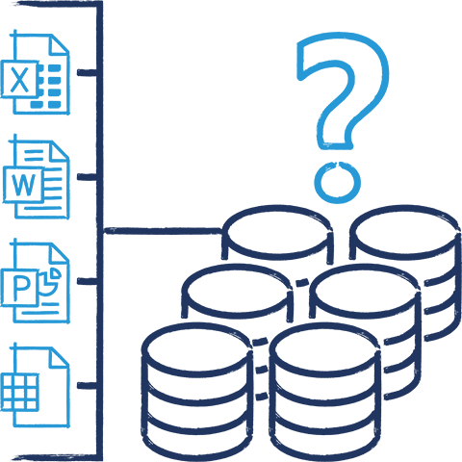
The Research Data Challenge
The problem with traditional workflows..
Data Silos: Information trapped in isolated files e.g Excel, REDCap and lab software
Human error: Manual copy-pasting and VLOOKUPs introduce invisible mistakes
Static Snapshots: A chart in a PDF is ”static” the moment it is published
The Goal: Move from static snapshots to a dynamic flow of evidence.
PowerBI can address this through unified connections, automated pipelines and dynamic updating

Slide 3
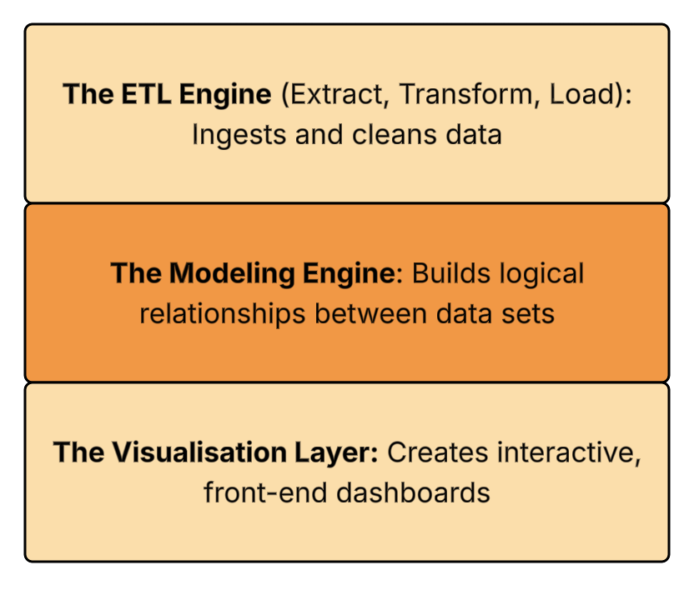
What is PowerBI?
The high-level concept:
The Three Core Pillars
Definition: A comprehensive, cloud-based business analytics service
Research Role: The bridge between raw data storage and interactive scientific communication
Not just charts..: An end-to-end data processing engine

Slide 4
Why PowerBI?
Choosing the right tool:
Excel vs Tableau vs Power BI
Excel
Familiar and flexible, but manual VLOOKUPs and copy-paste don’t scale — and every fix is invisible.
Same job, different tools: Most research groups already own Excel, and some have a Tableau licence somewhere
Where they fall short: Neither one records its own cleaning steps or refreshes itself when a data source changes
Cost, for context: Power BI Desktop is free for SETU staff and students — no separate licence to justify
Tableau
Polished visuals, but a separate licence cost and thinner native data-cleaning.
Power BI
Cleans, models and publishes in one free (for SETU staff) tool — with a full audit trail.
RECOMMENDED FOR RESEARCH

Slide 5
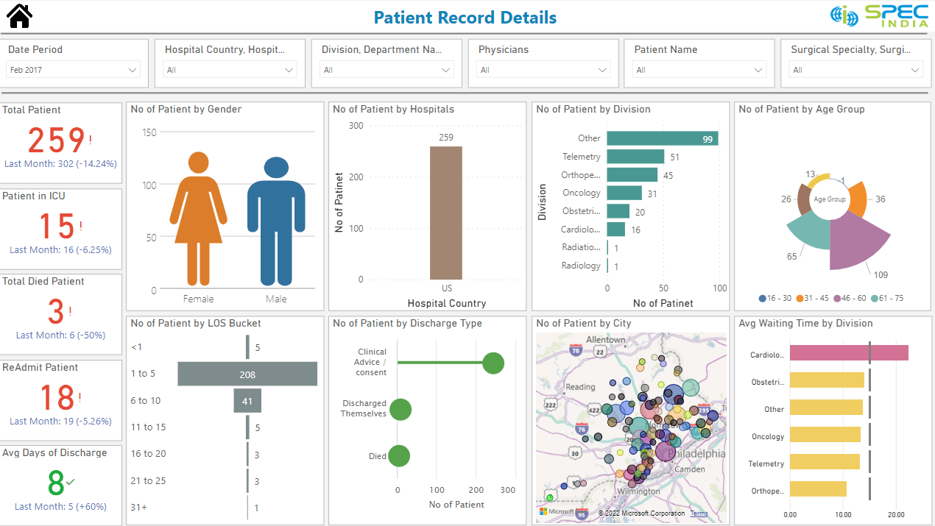
PowerBI & Reproducibility
Automating Your Audit Trail
Defined ‘Cleaning’: Alterations to data from a raw source can be cleaned and automated
Power Query “Applied Steps”: Every data transformation is recorded as sequential visual script. So reusable and reproducible
Radical Transparency: Peer reviewers and collaborators can see the exact series of actions to transform a raw data set into one of significance
Automated Efficiency: When a new batch of data arrives, it can be automated cleaned, visualised, ready for analysis

Slide 6
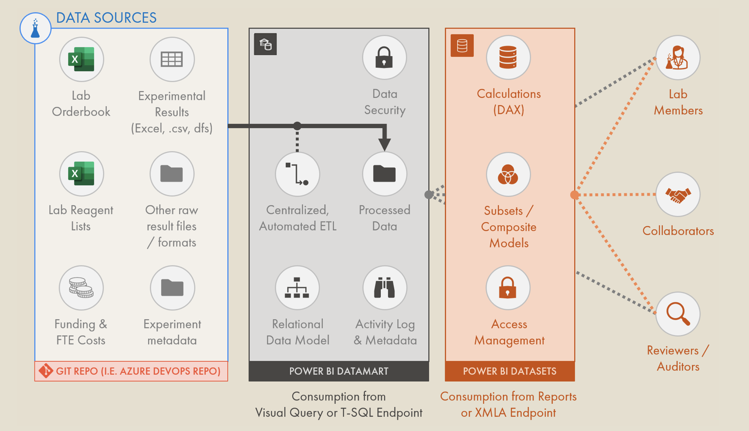
Advanced Analytics and Research Features
Scientific integration and interactivity
R and Python Integration: Run custom statistical models and complex visualisations (Heatmaps, violin plots) natively inside a dashboard
DAX Formulas: Create complex, dynamic calculations across millions of rows
AI Insight: Use built in machine learning features, for example identifying ‘key insights’ from a data set
* PowerBI Integrated into a data collection and lab use environment

Slide 7
Copilot AI & Advanced Analytics
Copilot in Power BI
Ask your data a question, in plain English
You ask:
“Which factor most affects patient drop-out?”
Copilot Q&A: Type a question in natural language and Copilot builds the visual for you, on the spot
R and Python, still there: Run custom statistical models and complex visuals (heatmaps, violin plots) natively inside a dashboard
Key Influencers: A built-in ML visual that automatically tests which variables drive an outcome you pick
Copilot answers:
“Age at enrolment and distance from site are the strongest predictors — here’s the chart.”
* PowerBI Copilot is available in Power BI Desktop and Service (Microsoft 365 licence required for full features)

Slide 8
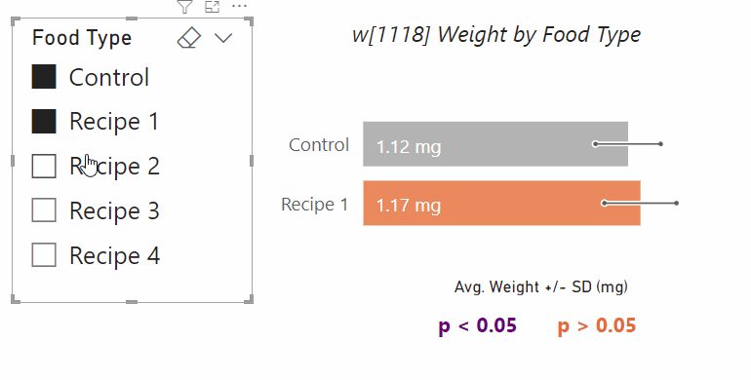
Scientific Impact Dissemination
Scientific integration and interactivity
Funder Alignment: Meets the growing mandates from bodies like the NIH, Horizon Europe for open science and interactive data communication
Publish to Web: Generate a secure URL to embed live, interactive dashboards directly into project websites. Example
Beyond the PDF: Allows policymakers, clinicians and the public to filter the data by their specific region or variable of interest
Accessible Data: Interactive, accessible data builds trust and drives greater engagement with your published papers
* Example of interactive visual from scientific data set

Slide 9
Mini-Walkthrough
Access: University Staff can access PowerBI through https://www.office.com.
Quick look at the platform: Using a public dataset — ClinicalTrials.gov study records (phase, status, enrolment, condition)

Slide 10
Where Power BI Falls Short
Learning curve
DAX and Power Query’s M language take real practice, not an afternoon
It's a tool, not a fix: Everything in this talk assumes you already understand your data and your stats — Power BI amplifies that, it doesn't supply it
The learning curve is real: DAX and Power Query's M language are proper languages in their own right — budget weeks of practice, not an afternoon
Not a stats package: You still need R, Python or SPSS for genuine inferential statistics — Power BI hosts them, it doesn't replace them
Governance is still your job: Someone on the team still has to own the RLS rules and the refresh schedule — they don't maintain themselves
Not a stats engine
You still need R, Python or SPSS for genuine inferential statistics
Garbage in, garbage out
A badly modelled dataset stays badly modelled — better visuals won’t fix it
Needs an owner
RLS rules and refresh schedules don’t maintain themselves
* None of this is a reason not to use it — just a reason to be honest about what it is

Slide 11
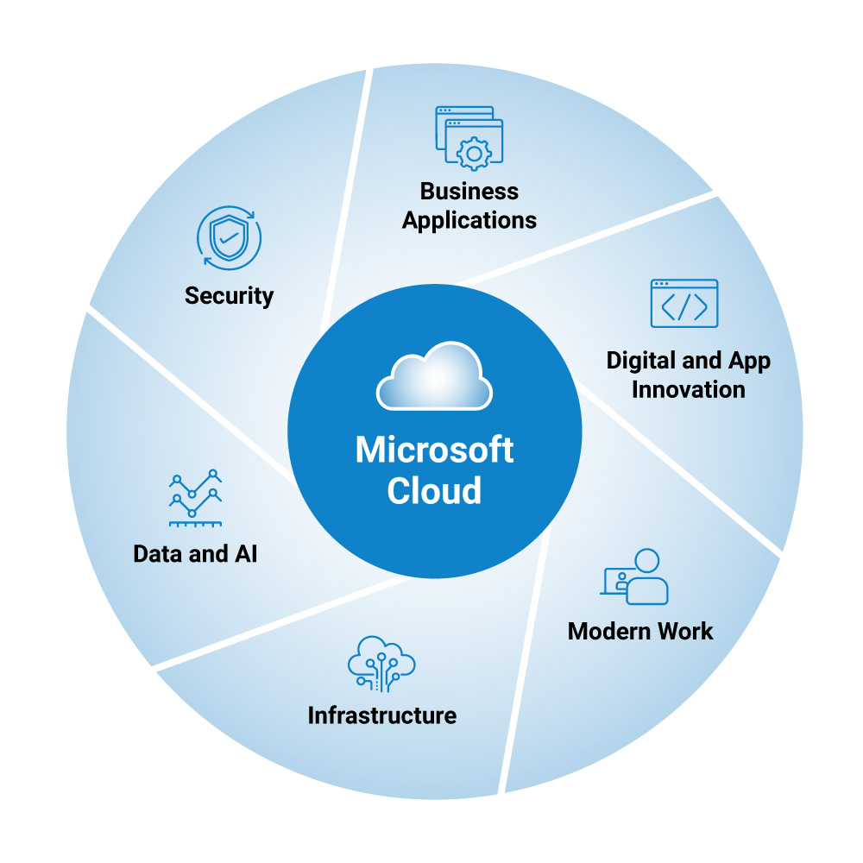
Ethics & Security
Compliant: Designed to meet strict GDPR and HIPAA standards when configured
Row-Level Security (RLS): Control exactly what data each user is allowed to see. Can be useful for FAIR data principals
One Dashboard, Multiple Views: A researcher at Site A only sees Site A’s patients, while the lead investigator can see the complete data set
Less emailed datasets: Eliminate security risks and chance of data loss
* PowerBI is part of the Microsoft Cloud

Slide 12
  Associated information:
  Data Goblins: The Value of Power BI brings to academia – Here
  Microsoft: Power BI Tutorial Sets - Here
  Geeks for Geeks: The Basics of PowerBI - Here
Thank you
Questions?

